Slide 1
Deliverable 4 & 5
Team Cloud

Slide 2
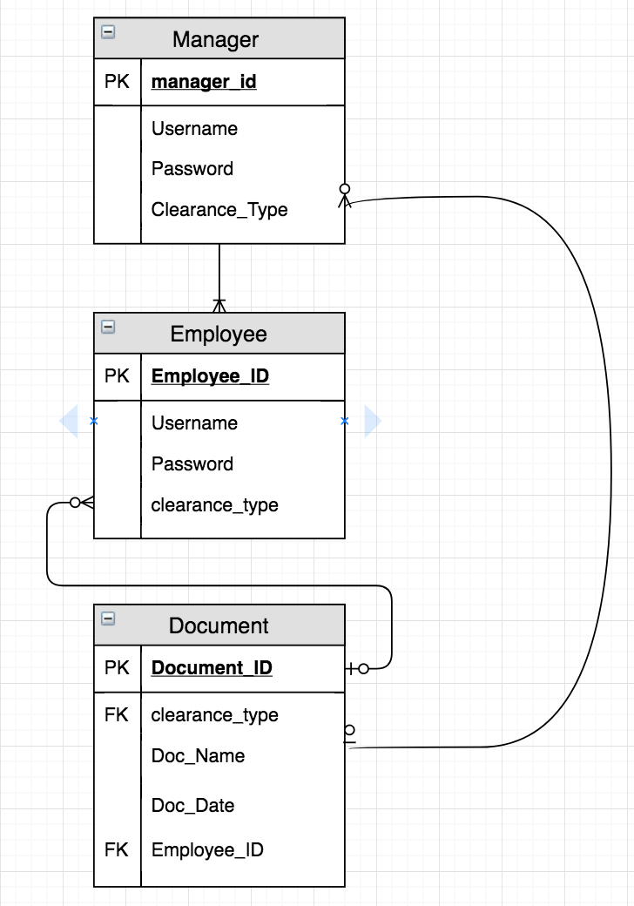
E-R Diagram
Employee Table:
ID, Username, Password, and clearance_type
Employees have access to one optional document
Manager Table:
ID, Username, Password, clearance_type
Access one optional document
Document Table:
ID, clearance_type, doc_name, doc_date, E_ID
Contains all docs that employees/managers that have the necessary clearance type have access to

Slide 3
Operational Requirements
Requirement | Description | Example
Technical | Specific hardware, Software, and Network requirements needed by business | Every location will have network connection with real-time updates to database
System Integration | System will have to obtain information from and interact with different systems | Different systems will have to interact to stay up to date with the data within the company
Portability | System will have to operate on mobile platforms | Device Accessed: Mobile, Tablet, Desktop Browser 1E11, Chrome OS supported: windows 7, 8, android
Maintainability | System will have to withstand the changes in the business and be able to adapt | Changes to documents and other files must be kept in check and up to date and accessible to different systems

Slide 4
Performance Requirements
Requirement | Description | Example
Speed | Amount of time needed for system to perform expected functions | Response Time: For Homepage 3 seconds For Operational Pages 5 seconds For reporting Pages 10 seconds
Capacity | Total number of users and requests the system can handle | Average Document Size: 300kb Database size limit per day: 200GB Database size limit after year 1: 5000GB
Availability/Reliability | Amount of time the system is available/ amount of downtime allowed | Minimum of 90% uptime, 99% at business/peak hour

Slide 5
Security Requirement
Requirement | Description | Example
Value system | Estimated value of system and data | The system and data will be worth around $500k-1 mil
Access control | Limit the ability to interact with system | Administrators- manage Users Contributors- Create Content Approvers- Create Content Viewers- Read Content
Encryption/Authentication | User must be authenticated to have access to server and encrypted server files | Login and certain level of clearance will be required to use different functions of the system
Virus Control | Controls to limit viruses | Files will be checked for viruses before being uploaded into system
Scalability | Ability to be changed in size | With potential business growth and more data/files being put into the system, the system must be able to handle it all and adapt

Slide 6
Cultural/Political requirements
Requirement | Description | Example
Multilingual | Languages offered by the system | English for Sharepoint, but potential for more with growth within company
Customization | Ability to change things in system | Users with specific clearances will have the ability to customize the systems and files within systems
Legal | Laws must be adhered by system and users | Privacy regulations and all other laws related to this specific system will be followed

Slide 7
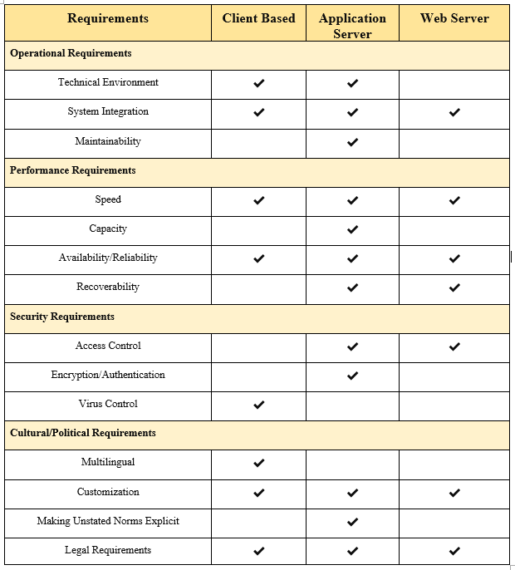
Matrix 1

Slide 8
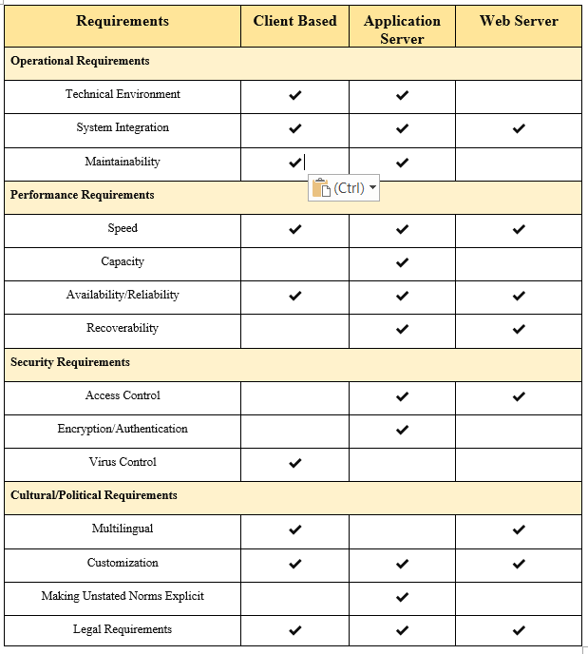
Matrix 2

Slide 9
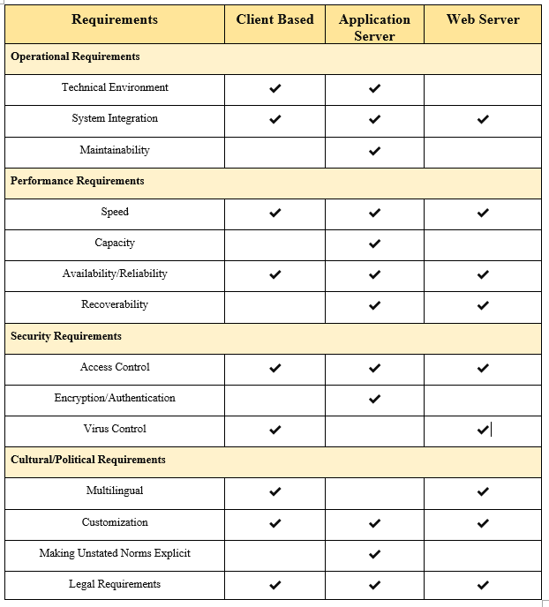
Matrix 3

Slide 10
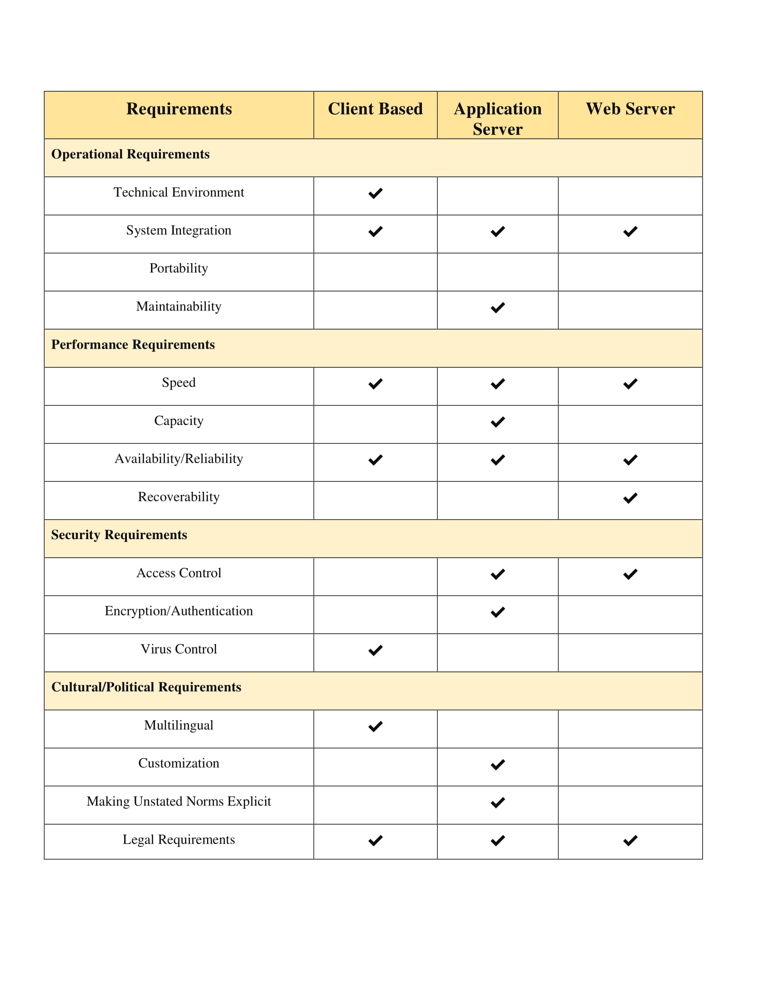
Decision Matrix
Nonfunctional Requirements and the Architecture Design

Slide 11
Hardware and Software Specification
 | Client | Sharepoint Server | SQL Server
Operating System | Windows, Mac, iOS, Android | Sharepoint Server 2016 | SQLOS on Windows Server
Recommended Hardware | Anything w/ browser capability | 32GBs RAM 64 bit, 4 Cores @ 2.1+, 1TB | +4GB RAM, 64 bit, 4 Cores, 2 TB
Network Speed | 1 Mbps or 4G | 1.5 Mbps<, <100ms latency | 3.0 Mbps<, <150ms latency

Slide 12
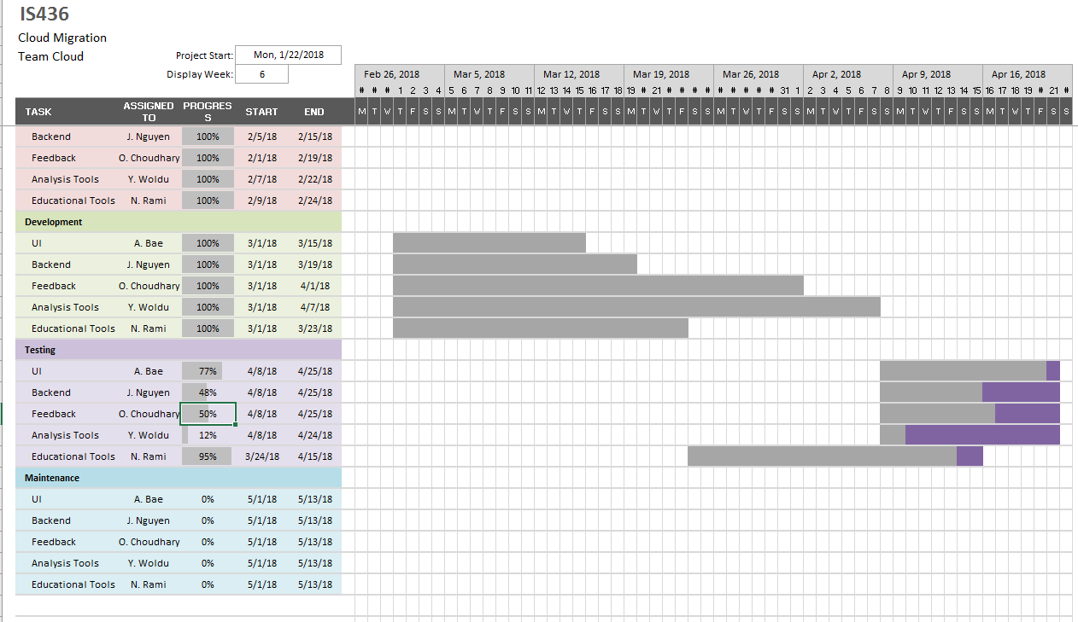
Updated Project Plan(4/13/18):

Slide 13
User Interface Design
Interface Standards:
Easy to access and understand
Logged transactions of document management
Sidebar/Toolbar for quick navigation

Slide 14
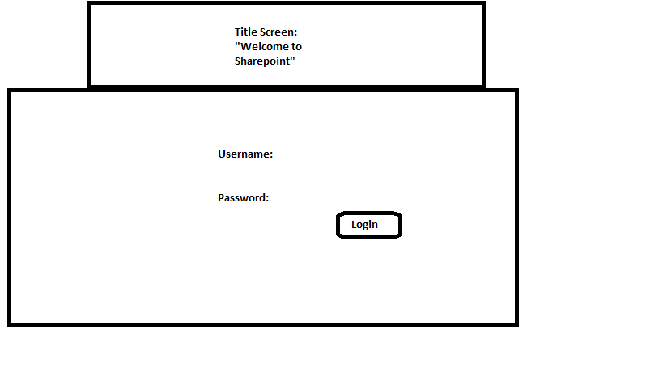
User Interface Design
Login Page:

Slide 15
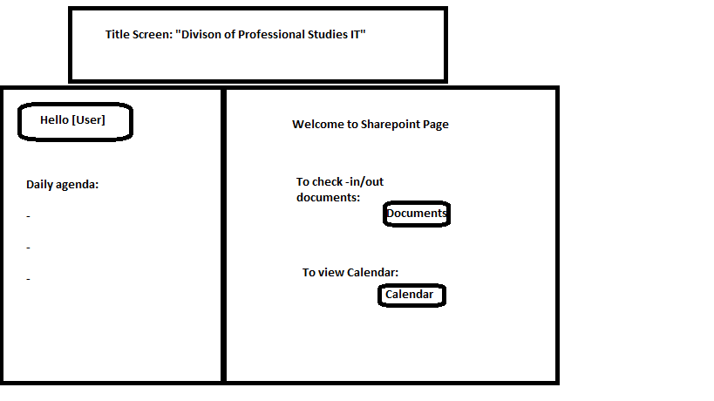
User Interface Design
Home Page:

Slide 16
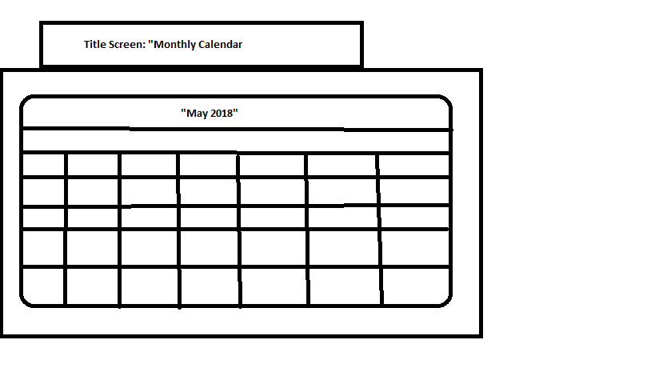
User Interface Design
Calendar:

Slide 17
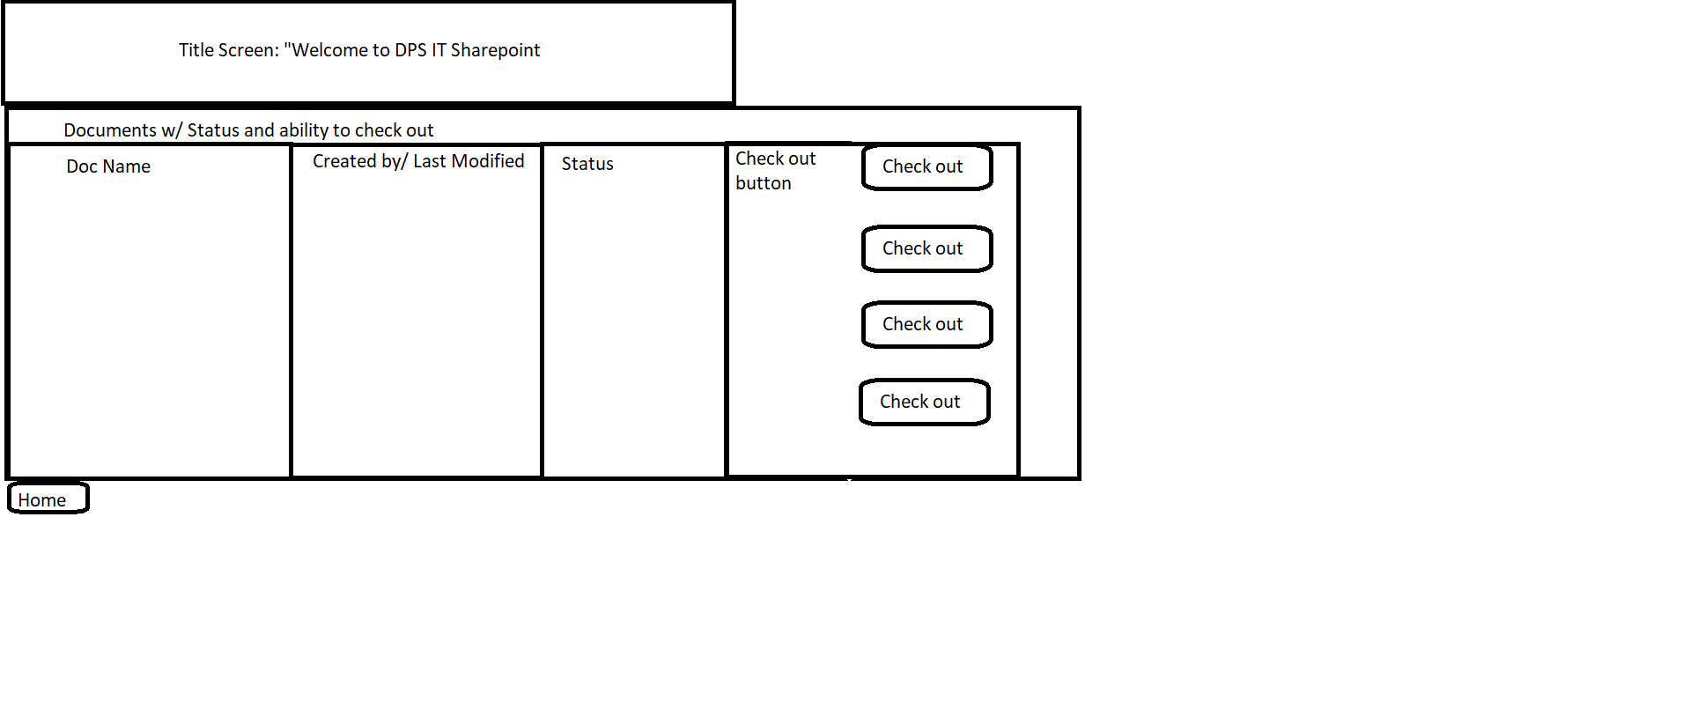
User Interface Design
Document Management:

Slide 18
Database Design
Employee Table: Employee_ID: Primary Key varchar(30) ++ID Username: varchar(30) Password: varchar(30) Clearance_type: varchar(30)
Document: Document_ID: Primary Key, varchar(30), ++ID Clearance_Type: Foreign Key, varchar(30) Doc_Name: varchar(30) Doc_Date: date(‘mm/dd/yyyy’)

Slide 19
Database Design
Manager: Manager_id: Primary Key, varchar(30), ++ID Password: varchar(30) Clearance_Type: varchar(30)

Slide 20
Demo of Program Design

Slide 21
System Implementation
Requirements:
Server with document management capabilities
Local computers for users
Local computers pre-installed with MS Office tools
Platforms: IE, Chrome, Firefox, Safari

Slide 22
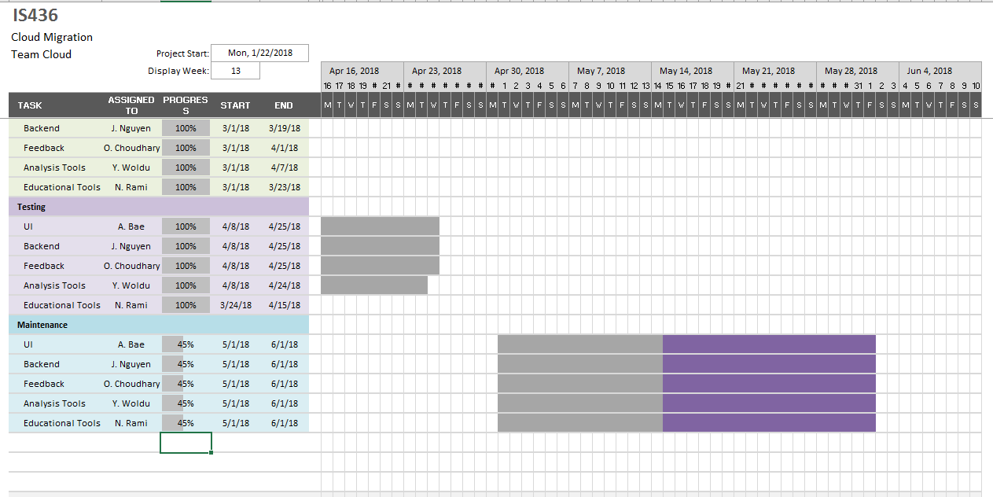
Updated Project Plan(5/14/18):

Slide 23
Kanban Board
https://kanbanflow.com/board/LCe3Q62m

Slide 24
SDLC Experience
Pros: | Cons:
Well documented methodology | Hard to fit unique project into SDLC model
Kept us on track, making sure things don’t fall through the cracks | SDLC has a difficult time with time budgeting
Produces prototypes for clients to see and visualize process | People cannot work independently (Task-based prerequisites)
Experience with SDLC (V-model) helps us in the real world | Communication was difficult due to lack of effective meeting times

Slide 25
Questions?

